Slide 1
Project 3: Movie Trends and Rankings
By: Nick Miller, John D’Aiutolo, Lincoln Martin

Slide 2
Overview
Using the data listed here we analyzed movie ranking from different genres of movies from January of 1995 to 2016. We highlighted specific years to provide a snapshot.
Rankings were provided from IMDB looking at 9742 movies over the above time period.

Slide 3
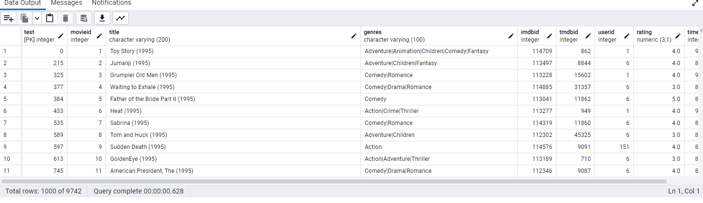
Database in pgAdmin

Slide 4
Questions
Question #1: In the Mid-1990’s what genres had the highest rated movies?
Question #2: Which years had the highest rated movies (1994-2016)?
Question #3: Which genres were the most popular over time (1994-2016)?

Slide 5
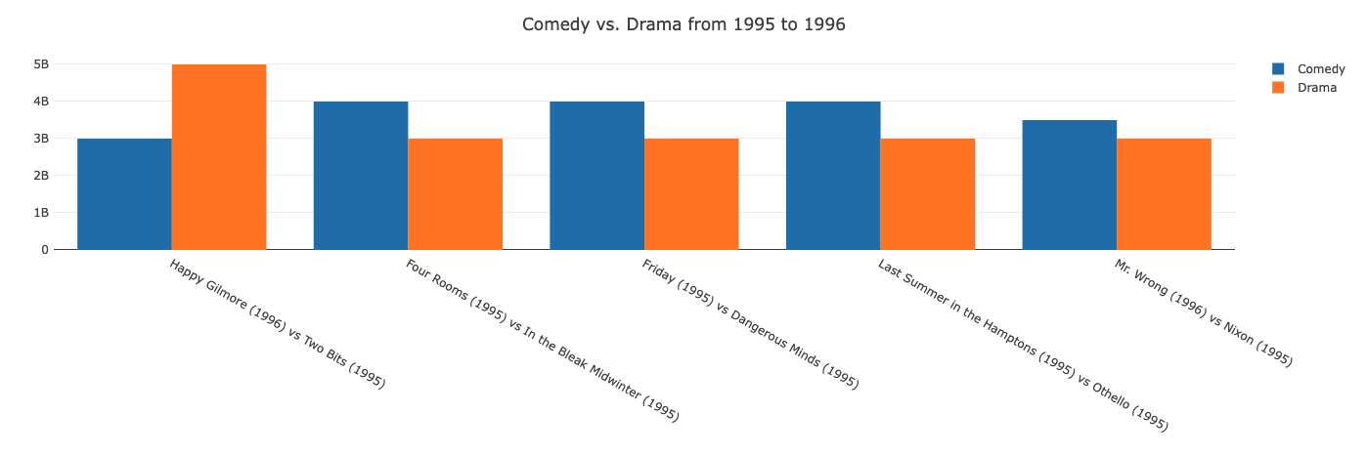
Question #1: Which years and genres had the highest rated movies?
Based on the bar chart of sample data below, during the years 1995 and 1996, comedy movies scored higher in general compared to drama movies. Drama’s total score was 17, while comedy’s was 18.5.
Drama scores remained more consistent with four of the five movies scoring a 3.

Slide 6
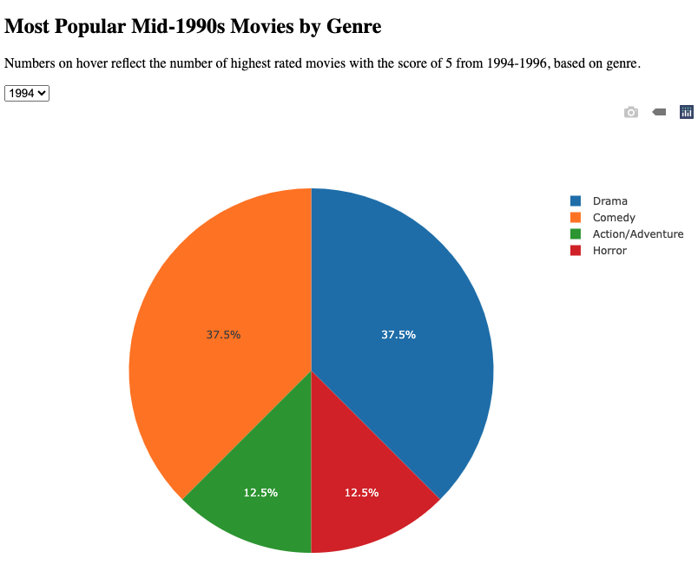
When referencing the pie chart to the right, four different movie genres from sample data were observed: Drama, Comedy, Action/Adventure, and Horror.
In 1994, comedy and drama movies took up 75% of the highest rated scores.

Slide 7
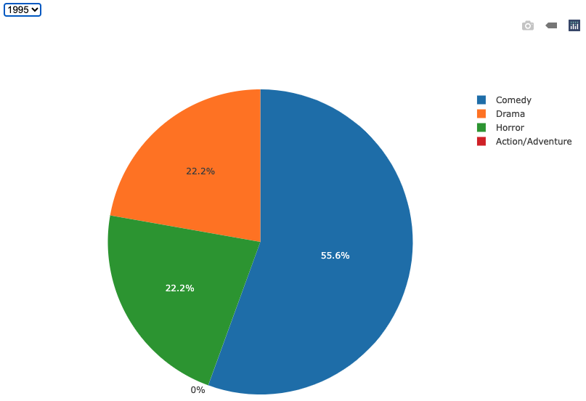
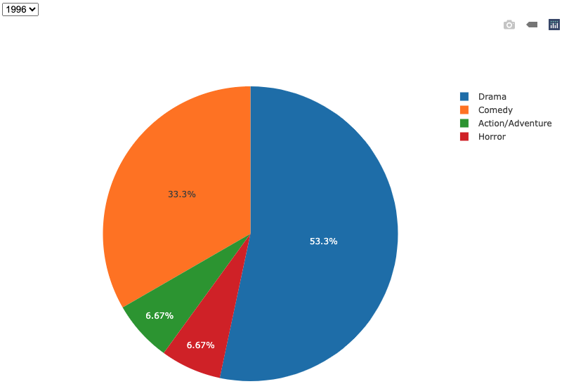
Alternatively, when observing the same genres in 1995 and 1996, it can be determined that comedy movies were higher rated in 1995, and drama movies in 1996.
When analyzing the entire dataset, in general, comedy and drama movies had more higher rankings (rankings of 5).
Based on the data from these three years, it can be determined that drama was the most popular movie genre based on this particular dataset.

Slide 8
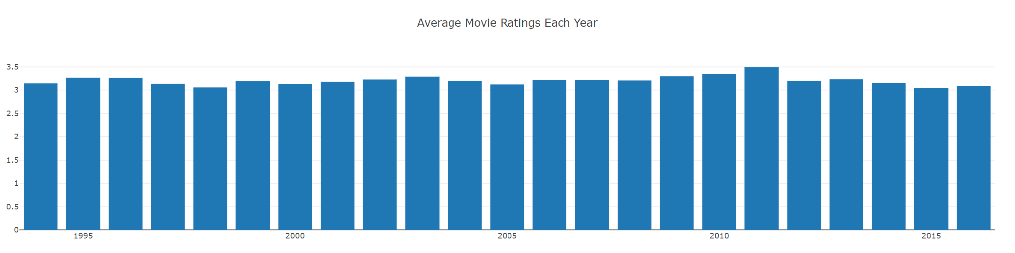
Question #2: Which years had the highest rated movies (1994-2016)?
The graph reflects a high degree of parity between the average ratings over the course of each year.
There is no discernable trend up or down over time. If anything, scores seem to gradually rise before declining again in 5 year increments, like small waves.

Slide 9
Question #2: Which years had the highest rated movies (1994-2016)?
All of the scores fall between 3-3.5. 2011 had the highest average (3.495) while 2015 had the lowest average (3.042).
Given that both the highest and lowest averages fall within the last five years of the dataset, it cannot be said that movies have gotten better or worse over time according to the critic scores within the data

Slide 10
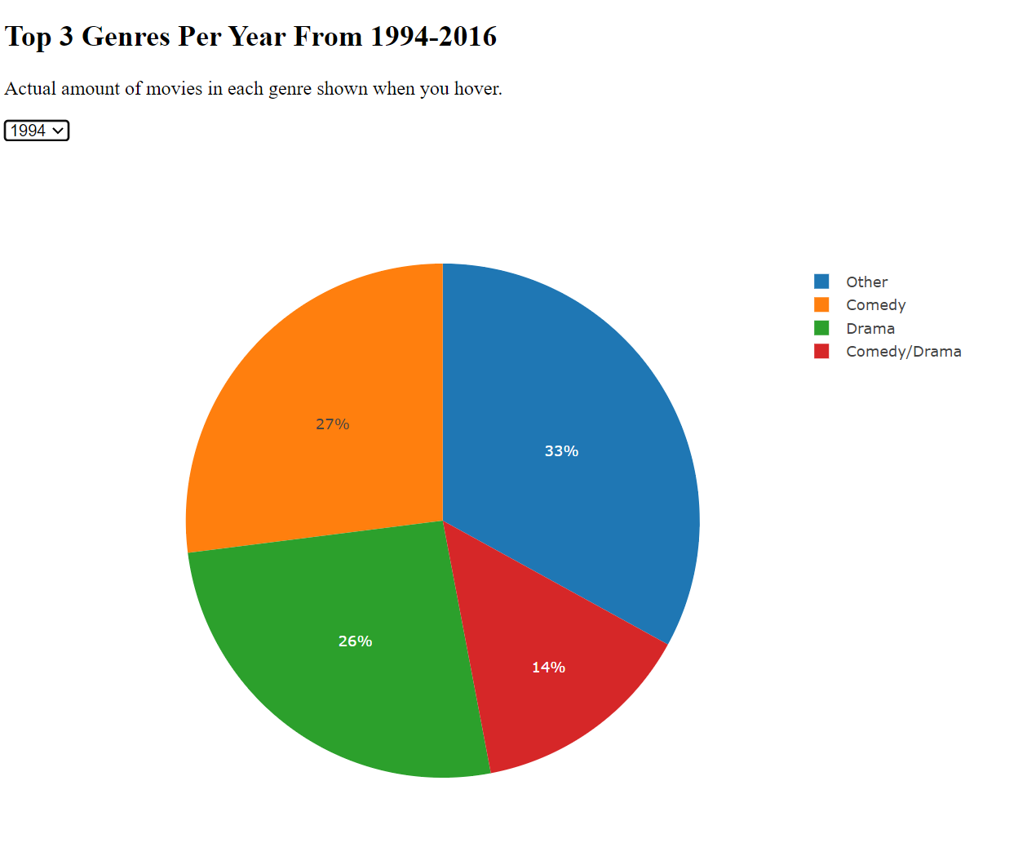
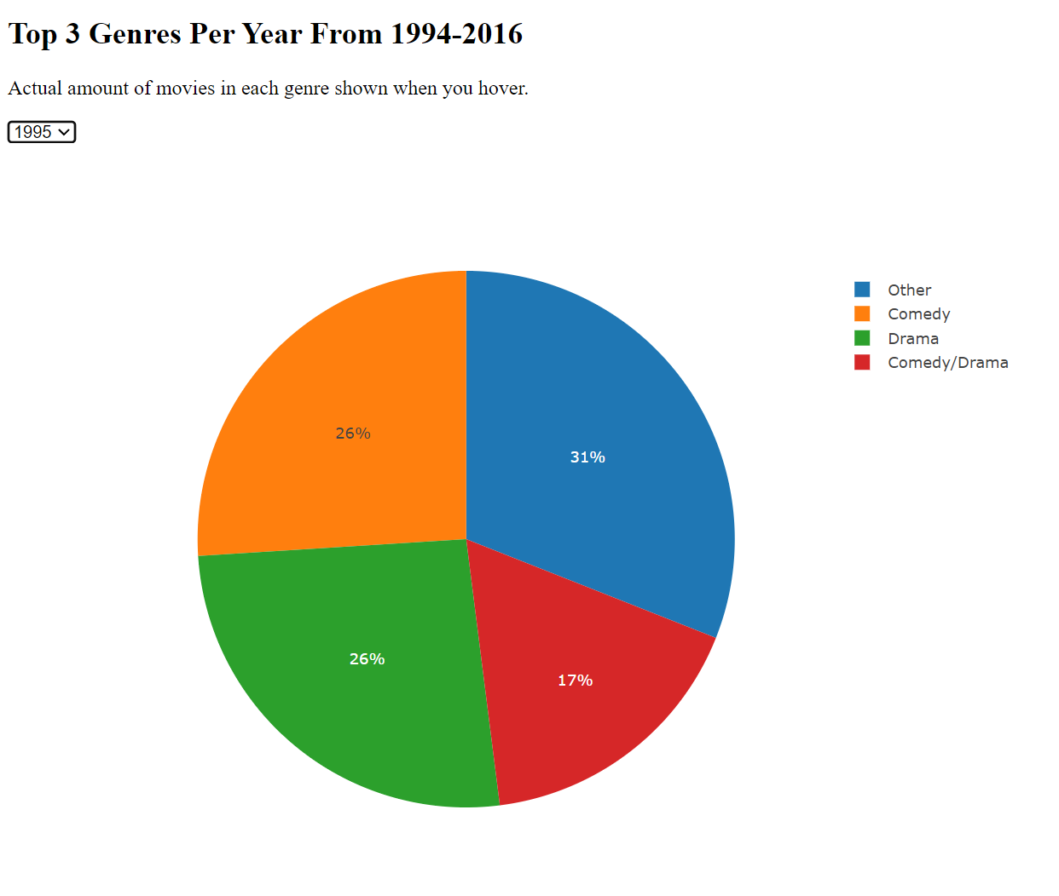
Question #3: Which genres were the most popular over time (1994-2016)?
Comedies and Dramas. By far.
In many of the years, Comedies and Dramas (or a combination of the two) were about as much as all of the other genres combined.

Slide 11
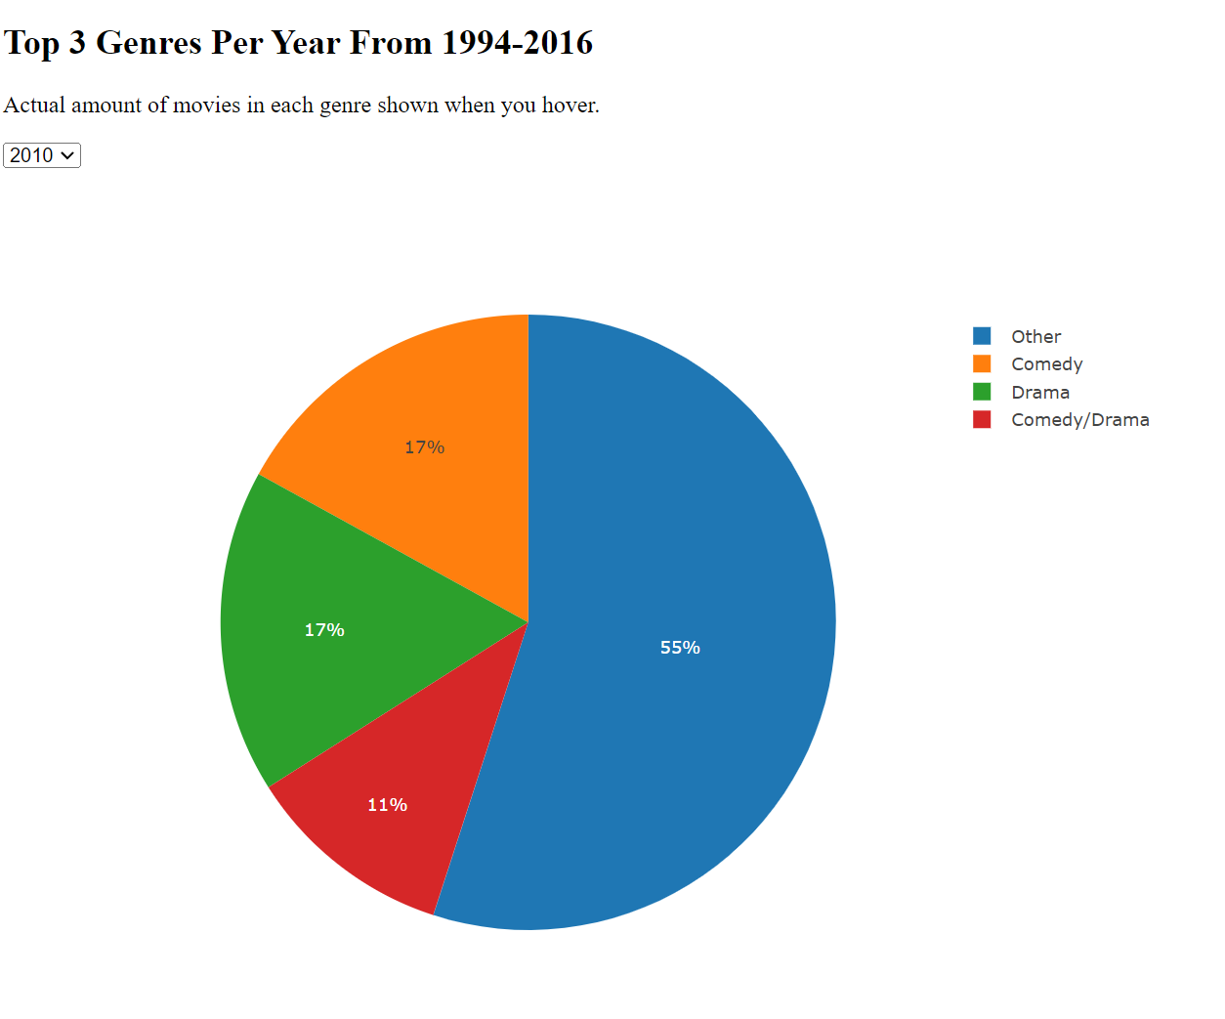
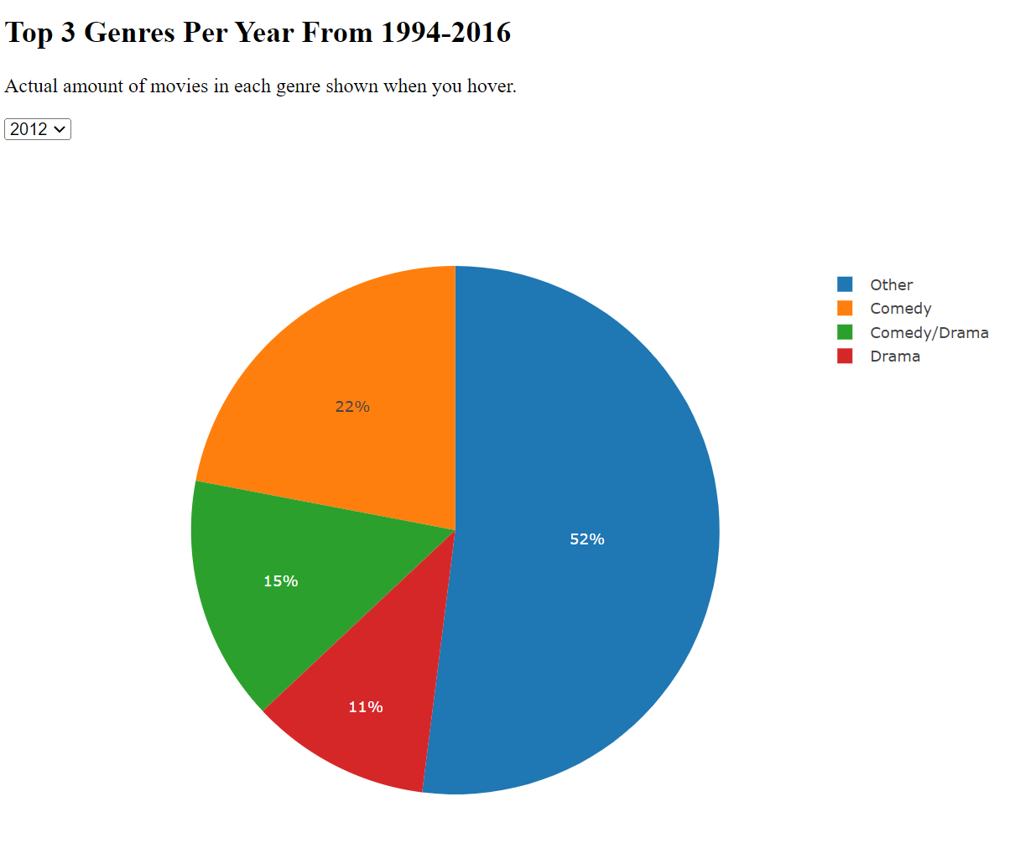
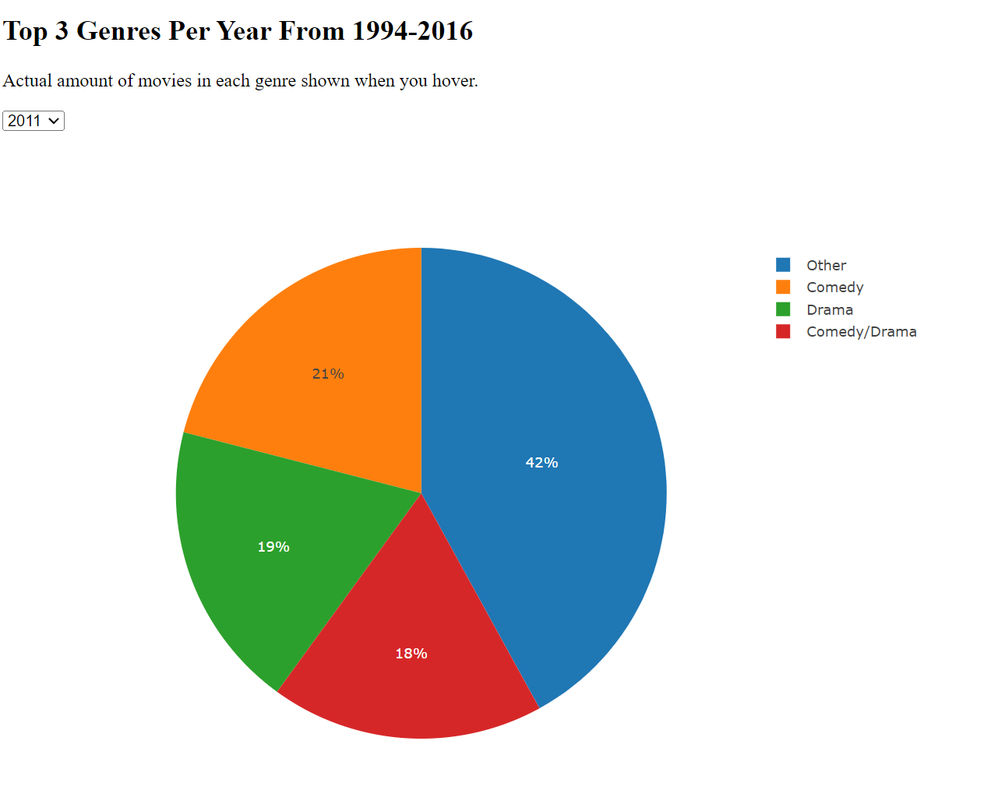
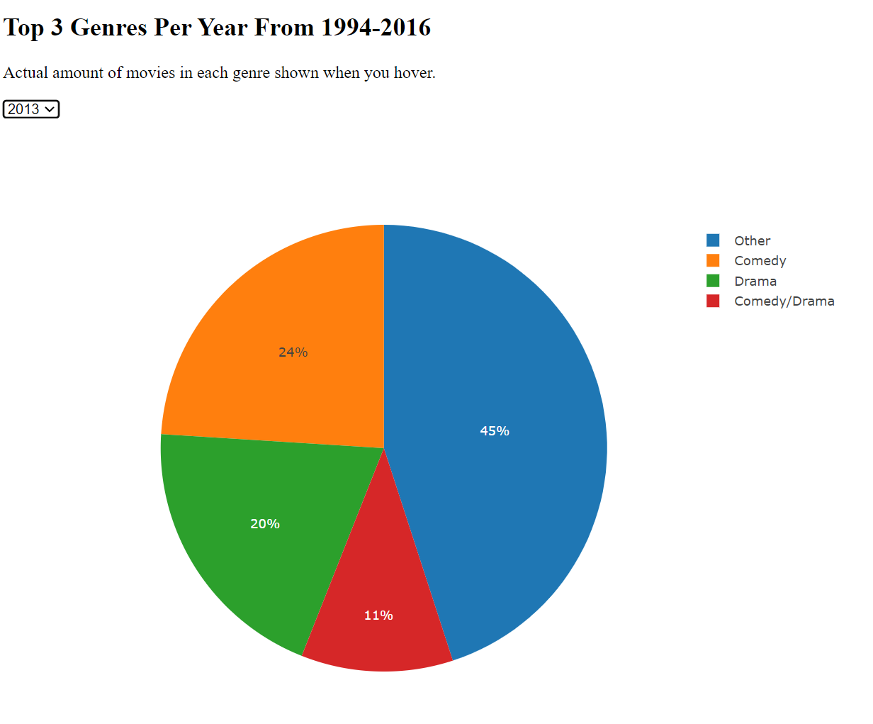
While Comedies and Dramas still dominate the screens today, there has been evidence of a recent decline
These 4 charts are from 2010-2013, and as you can see the Comedy and Drama slices are smaller than in 1994-1995
More movies are being made today than ever, and with it has come more diversity in the genres they’re about

Slide 12
Conclusions
Movies haven’t gotten better or worse over the years
Comedies and Dramas have always (and probably will always) be king, but there has been recent disparity in genres

Slide 13

Thank you!

